Slide 1
組員： F110112112 林書弘 F110112114 張博凱 F110112125 洪胤凱 F110112130 NAWISA
五子棋 Gomoku

Slide 2
情境 Situation
想要知道在兩個相同條件下訓練的旗手，是否有因為先後手的不同，而影響到什麼差異，是否影響使模型強大。
Reward
獲得分數
藉由獲得的分數來決定最佳下棋位置
RL Agent
State
Action
將棋子放置棋盤
或結束遊戲
回合判斷
棋局判斷
活三
活四
長連
判斷是否結束
TrainingData
ResetGame
Featurevector
End
生成棋譜
結束遊戲

Slide 3
需求 Requirement
與訓練好的電腦再進行人機對戰，會不會有難度
讓電腦能辨識直線、橫線、斜線連線
能判斷狀態適時進行進攻或防守
創造一個10*10的場地空間

Slide 4
分析 Analyze
系統
遊戲內容
ML訓練
規則
物件UI
強化式學習模型
獎賞(reward)
狀態(state)
動作(action)
獲勝
直、橫、斜線五子連棋
黑子、白子
棋盤
將棋子放置棋盤進行攻擊或防禦
獲得分數
活三、活四、禁手、長連
回合判斷
平局
直、橫、斜線無五子連棋且棋盤滿子
棋局
遊戲結束
判斷是否結束
樣本
棋局棋譜
Monte-Carlo-tree-search
CNN
節點增加

Slide 5
分析 Analyze
快速、大量、有效：
每一局的棋譜記錄下來，並當成訓練的特徵
使用蒙特卡洛樹搜索，讓五子棋在下棋前搜索多種最佳位置，且配合歷史數據，來對應位置。
特徵向量(Feature vectors)：
每一局自我學習棋譜(棋盤狀態矩陣)，並在每100建立一個最佳模型，並且對弈，決定是否保留為最佳模型。

Slide 6
設計 Design
初始化
物件UI
規則
初始化
Monte-Carlo-tree-search
RL Agent
棋局棋譜
遊戲結束

Slide 7
設計 Design
Monte-Carlo-tree-search
CNN
Select
Expand and Evaluation
Backup
回合判斷
棋譜判斷
節點增加
Q值
Play
將棋子放置棋盤進行攻擊或防禦
或遊戲結束

Slide 8
設計 Design-API
初始化
Name：chess_board
輸入：EMPTY = int 、 BLACK = int 、 WHITE = int 、board_len : int、clear_board、board[]
輸出：self.state
Method：棋盤初始化
初始化__init__
Chessboard棋盤 | board_len : 10 棋盤邊長
 | EMPTY = -1
 | BLACK = 1
 | WHITE = 0
 | board [ ] 棋盤陣列

Slide 9
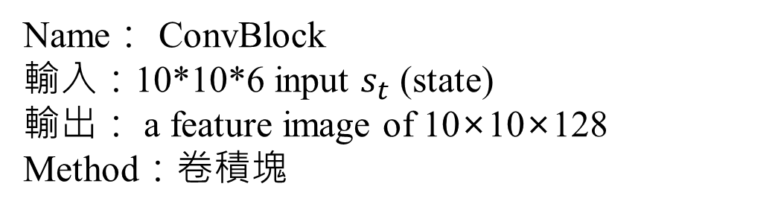
設計 Design-API
CNN
Name： ConvBlock
輸入：10*10*6 input $s_{t}$ (state)
輸出： a feature image of 10×10×128
Method：卷積塊
class ConvBlock(nn.Module):
“”“ 卷積塊 """
def __init__(self, in_channels: int, out_channel: int, kernel_size, padding=0):
super().__init__()
self.conv = nn.Conv2d(in_channels, out_channel,
kernel_size=kernel_size, padding=padding)
self.batch_norm = nn.BatchNorm2d(out_channel)
def forward(self, x):
return F.relu(self.batch_norm(self.conv(x)))

Slide 10
設計 Design-API
class ResidueBlock(nn.Module):
“”“ 残差塊 """
def __init__(self, in_channels=128, out_channels=128):
"""
Parameters
----------
in_channels: int
輸入圖像通道數
out_channels: int
輸出圖像通道數
"""
super().__init__()
self.in_channels = in_channels
self.out_channels = out_channels
self.conv1 = nn.Conv2d(in_channels, out_channels,
kernel_size=3, stride=1, padding=1)
self.conv2 = nn.Conv2d(out_channels, out_channels,
kernel_size=3, stride=1, padding=1)
self.batch_norm1 = nn.BatchNorm2d(num_features=out_channels)
self.batch_norm2 = nn.BatchNorm2d(num_features=out_channels)
def forward(self, x):
out = F.relu(self.batch_norm1(self.conv1(x)))
out = self.batch_norm2(self.conv2(out))
return F.relu(out + x)
CNN
Name： ResidueBlock
輸入：a feature image of 10×10×128
輸出：a feature image of 10×10×128
Method：提高網絡的特徵提取能力，防止梯度消失問題

Slide 11
設計 Design-API
class PolicyHead(nn.Module):
“”“ 策略頭 """
def __init__(self, in_channels=128, board_len=10):
"""
Parameters
----------
in_channels: int
輸入通道數
board_len: int
棋盤大小
"""
super().__init__()
self.board_len = board_len
self.in_channels = in_channels
self.conv = ConvBlock(in_channels, 2, 1)
self.fc = nn.Linear(2*board_len**2, board_len**2)
def forward(self, x):
x = self.conv(x)
x = self.fc(x.flatten(1))
return F.log_softmax(x, dim=1)
CNN
Name： PolicyHead
輸入：a feature image of 10×10×128
輸出：10×10 = 100 的移動概率向量 p
Method：可能的舉動和建議的舉動

Slide 12
設計 Design-API
v
class ValueHead(nn.Module):
“”“ 價值頭"""
def __init__(self, in_channels=128, board_len=10):
"""
Parameters
----------
in_channels: int
輸入通道數
board_len: int
棋盤大小
"""
super().__init__()
self.in_channels = in_channels
self.board_len = board_len
self.conv = ConvBlock(in_channels, 1, kernel_size=1)
self.fc = nn.Sequential(
nn.Linear(board_len**2, 128),
nn.ReLU(),
nn.Linear(128, 1),
nn.Tanh()
)
def forward(self, x):
x = self.conv(x)
x = self.fc(x.flatten(1))
return x
CNN
Name：ValueHead
輸入：a feature image of 10×10×128
輸出：v = [-1,1]區間
Method：預測當前玩家是贏還是輸的結果（結果：從-1到1）

Slide 13
設計 Design-API
Monte-Carlo-tree-search
Name：Monte-Carlo-tree-search
輸入：
輸出：self.state
Method：進行蒙地卡羅樹搜尋
地卡羅樹搜尋(Monte-Carlo-tree-search)
AlphaZeroMCTS 蒙地卡羅樹搜尋 | policy_value_net:PolicyValueNet策略價值網絡
 | c_puct:float探索常數
 | n_iters:int迭代次數
 | is_self_play:bool是否處於自我對弈狀態
get_action 根據當前局面返回下一步動作 | chess_board:ChessBoard棋盤
 | action:int當前局面下的最佳動作
Node 蒙地卡羅樹節點 | parent:Node父級節點
 | child:Node子級節點
 | c_puct:float探索常数

Slide 14
設計 Design-API
回合判斷
棋局判斷
Name：which_player、self.state
輸入：int:current_playe、array：directions、self.state
輸出：self.state
Method：判斷棋盤上的棋子位置
訓練資料樣本
which_player、self.state | int:current_player當前玩家
save_model | array：directions搜索方向 directions=[[(0,-1),(0,1)],#水平搜索 [(-1,0),(1,0)],#垂直搜索 [(-1,-1),(1,1)],#主對角線搜索 [(1,-1),(-1,1)]]#副對角線搜索
__load_data | self.state棋盤狀態
 | state=OrderedDict狀態紀錄

Slide 15
設計 Design-API
節點增加
Name：Node
輸入：action_probs
輸出：self.children[action]
Method：添加一個或多個子節點展開樹並模擬產生結果
def expand(self, action_probs: Iterable[Tuple[int, float]]):
“”“ 拓展節點
Parameters
----------
action_probs: Iterable
每個元素都為 `(action, prior_prob)` 元组，根據這個元組創建子節點 ，
`action_probs`的長度為當前棋盤的可用落點的總數
"""
for action, prior_prob in action_probs:
self.children[action] = Node(prior_prob, self.c_puct, self)

Slide 16
設計 Design-API
Q值
Name：__update
輸入：(self.N * self.Q + value)/(self.N + 1)
輸出：self.Q
Method：計算分數
Q值
self.N | 節點的訪問次數`N(s, a)’
self.Q | 節點的累積平均獎勵`Q(s, a)`
value | 更新節點的內部數據

Slide 17
設計 Design-API
將棋子放置棋盤
進行攻擊或防禦
Name：action
輸入：action:int、is_over:bool、winner:int
輸出：do_action
Method：執行下子或是判斷遊戲結束了沒
動作(Action)
do_action 落子並更新棋盤 | action:int落子位置
is_game_over 判斷遊戲是否結束 | is_over:bool遊戲是否結束，分出勝負或者平局則為`True`,否則為`False`
 | winner:int遊戲贏家

Slide 18
設計 Design-API
棋局棋譜
Name：SelfPlayDataSet
輸入：SelfPlayDataSet
輸出：save_model
Method：結束遊戲後將此局遊戲保存
訓練資料樣本
SelfPlayDataSet | 自我對弈數據集類
save_model | 保存模型

Slide 19
設計 Design-API
Training
Name：Train
輸入：
輸出：best_model=torch.load(model_path)
Method：尋找最佳模型
__init__(self,board_len=9,lr=0.01,n_self_plays=1500,n_mcts_iters=500,
n_feature_planes=4,batch_size=500,start_train_size=500,check_frequency=100,
n_test_games=10,c_puct=4,is_use_gpu=True,is_save_game=False,**kwargs):

Slide 20
設計 Design-API
RL
TrainModel 訓練模型 可調整參數 | board_len:int棋盤大小
 | lr:float學習率
 | n_self_plays:int自我博弈遊戲局數
 | n_mcts_iters:int蒙特卡洛樹搜索次數
 | n_feature_planes:int特徵平面個數
 | batch_size:intmini-batch的大小
 | start_train_size:int開始訓練模型時的最小數據集尺寸
 | check_frequency:int測試模型的頻率
 | n_test_games:int測試模型時與歷史最優模型的比賽局數
 | c_puct:float探索常數
 | is_use_gpu:bool是否使用GPU
 | is_save_game:bool是否保存自對弈的棋譜

Slide 21
程式 Coding
Initial state
Alpha zero MCTS
Chess board
Node
Policy value net
Roll out MCTS
Self play dataset
Training
Game

Slide 22
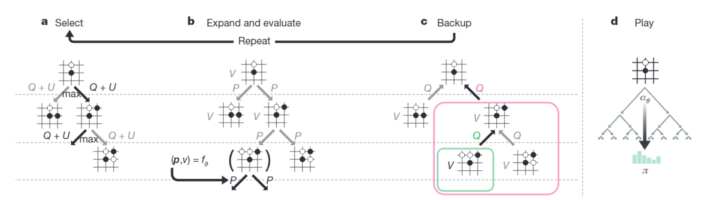
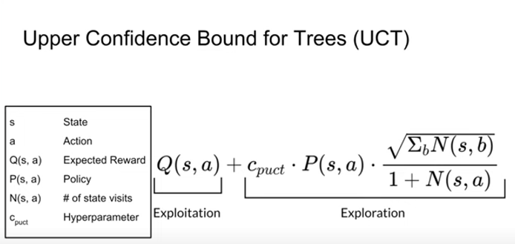
Node.py (board positions(棋盤位置)/states(狀態)) Monte Carlo tree search
Upper Confidence Bound (UCT)

Slide 23
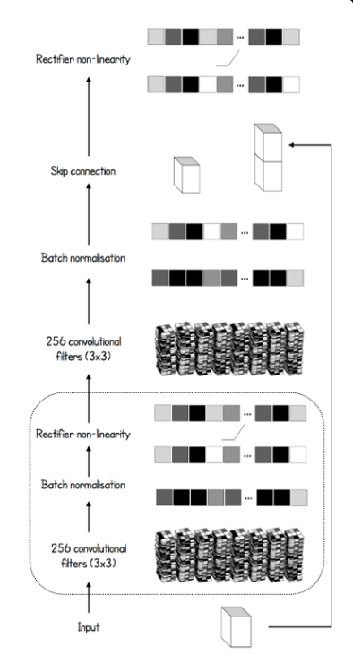
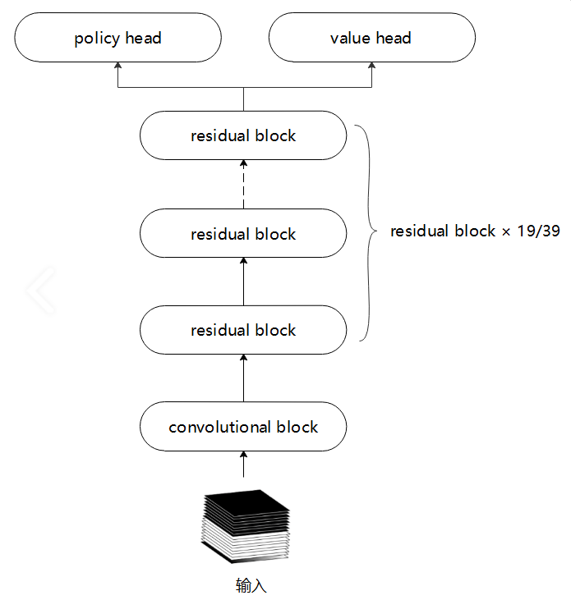
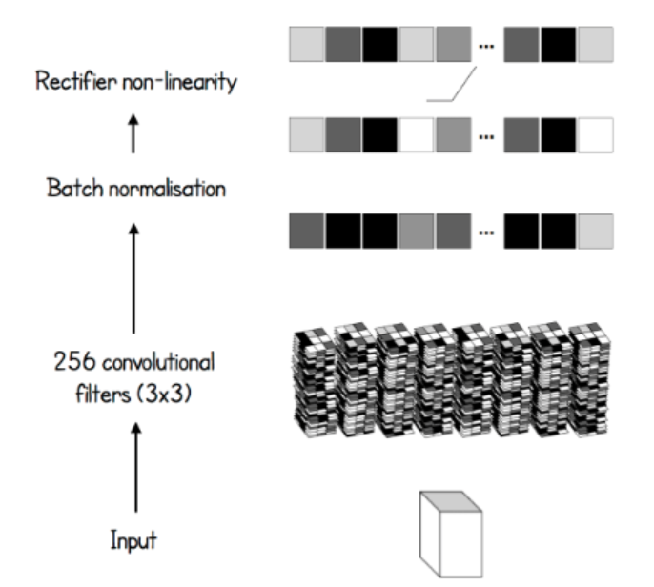
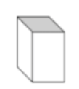
Policy_value_net.py Model Structure(模型結構)

Slide 24
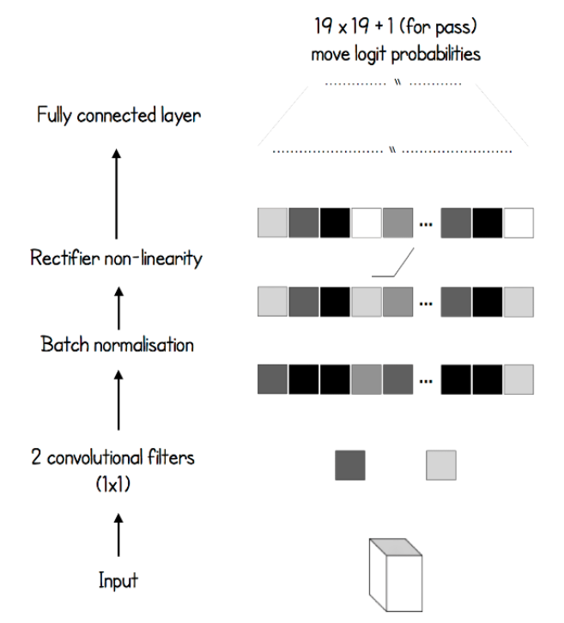
Model Structure
v

Slide 25
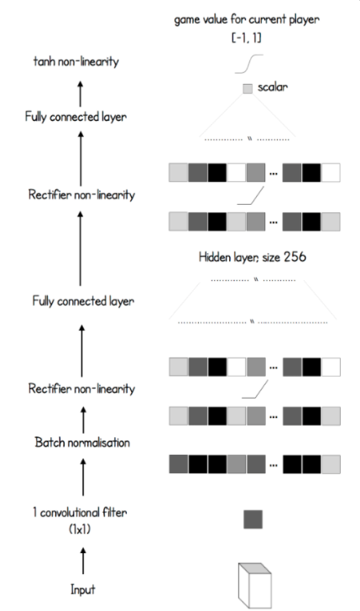
Model Structure

Slide 26
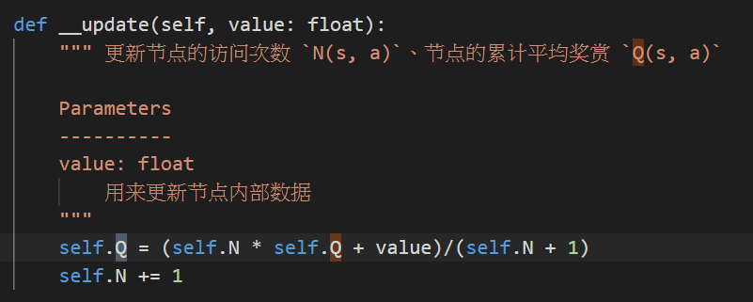
Q值
Q value
節點的累計平均獎賞 Q(s, a)
利用蒙特卡羅樹節點的訪問次數來產生數值

Slide 27
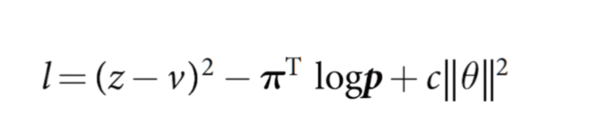
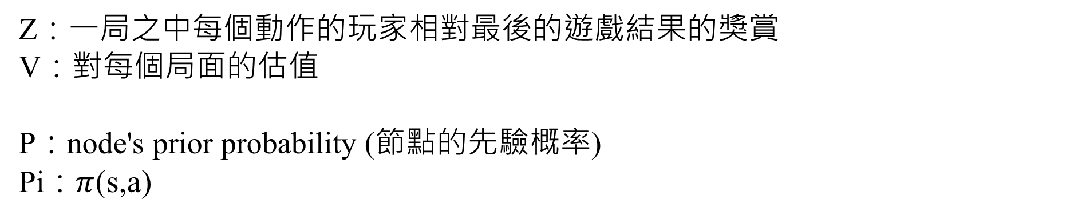
Train.py
Loss function
均方誤差 (MSE)
Mean square Error (MSE)
交叉熵損失
Cross entropy loss
正則化項
Regularization term
Z：一局之中每個動作的玩家相對最後的遊戲結果的獎賞
V：對每個局面的估值
P：node's prior probability (節點的先驗概率)
Pi：$π$(s,a)

Slide 28
損失函數 Loss function
第一項z和v的均方差誤差，希望神經網路能在給出一個棋局的情況下盡可能地給出正確的勝利或失敗值。
如果這個值足夠正確，那麼我們在測試階段進行預測的時候，落一個子就能一清二楚地判斷棋局最後是勝是負，從而給出一個合理的value去決定這個落子位置的價值。 第二項是p和pi的Entropy 。當p和pi越接近，l的值就越小，模型就越好。理解的方法是，在模擬的時候會給出p值，p值越大則我們去訪問的概率就越大，最後我們選擇落子的概率就越大。我們知道，pi是MCTS在一系列的模擬之後選擇出來的最優解，如果p和這個值接近那麼我們就可以直接選擇最優解而不用繞彎路。我們可以想像，當我們在回顧的過程中計算出來一個落子概率分佈p，而真實的pi則和p很接近，也就是說我們走了最應該走的道路，從而l的值就很小。反過來說，當我們的模型足夠優秀的時候，我們應該可以直接給出落子最優解，因為從"未來"的角度看，我一定會選擇這種落子方案。 第三項是一個L2懲罰項，防止過擬合。
Notes:
The MSE of the first term z and v, hope that the neural network can give the correct victory or defeat value as much as possible given a chess game.
If this value is correct enough, then when we make predictions in the testing phase, we can clearly judge whether the game is won or lost by dropping a piece, so as to give a reasonable value to determine the value of the position of the move.
The second term is the Entropy of p and pi.
When p and pi are closer, the value of l is smaller, and the model is better. The way to understand is that the p value will be given during the simulation. The larger the p value, the greater the probability that we will visit, and the greater the probability that we will choose a place in the end. We know that pi is the optimal solution selected by MCTS after a series of simulations. If p is close to this value, then we can directly select the optimal solution without detours. We can imagine that when we calculate a placement probability distribution p during the review process, and the real pi is very close to p, that is to say, we have walked the path that we should take, so the value of l is very small. Conversely, when our model is good enough, we should be able to directly give the optimal solution for the placement, because from a "future" perspective, I will definitely choose this placement solution. The third term is an L2 penalty term to prevent overfitting.

Slide 29
訓練過程
Training Process
作業系統：Windows 11
中央處理器(CPU)：Intel®core™ - i7 - 10750H
顯示卡(GPU)：Nvidia - GTX1660ti – 6GB
記憶體：16GB
程式軟體：VScode --- Python(Pytorch)
2 days of training(2天的訓練 )
5000games of self play generated(產生了5000場自我遊戲 )
500 simulations for each MCTS(每個 MCTS 進行 500 次模擬)
Notes:
The MSE of the first term z and v, hope that the neural network can give the correct victory or defeat value as much as possible given a chess game.
If this value is correct enough, then when we make predictions in the testing phase, we can clearly judge whether the game is won or lost by dropping a piece, so as to give a reasonable value to determine the value of the position of the move.
The second term is the Entropy of p and pi.
When p and pi are closer, the value of l is smaller, and the model is better. The way to understand is that the p value will be given during the simulation. The larger the p value, the greater the probability that we will visit, and the greater the probability that we will choose a place in the end. We know that pi is the optimal solution selected by MCTS after a series of simulations. If p is close to this value, then we can directly select the optimal solution without detours. We can imagine that when we calculate a placement probability distribution p during the review process, and the real pi is very close to p, that is to say, we have walked the path that we should take, so the value of l is very small. Conversely, when our model is good enough, we should be able to directly give the optimal solution for the placement, because from a "future" perspective, I will definitely choose this placement solution. The third term is an L2 penalty term to prevent overfitting.

Slide 30
來源資料及參考資料：
Sources and References：
如何使用自對弈強化學習訓練一個五子棋機器人Alpha Gobang Zero：
https://www.cnblogs.com/zhiyiYo/p/14683450.html
GITHUB：
https://github.com/zhiyiYo/Alpha-Gobang-Zero
自製Alpha Go，基於深度增強學習和蒙特卡洛樹搜索的五子棋AI（強化學習入門） https://zhuanlan.zhihu.com/p/59567014?fbclid=IwAR2OZFAZbCtL9_qNQty04oR0KxC-P_Ny945IoGJFez3mJv_ITQ03O9uXTc0
GITHUB：
https://github.com/pandezhao/alpha_sigma
Notes:
The MSE of the first term z and v, hope that the neural network can give the correct victory or defeat value as much as possible given a chess game.
If this value is correct enough, then when we make predictions in the testing phase, we can clearly judge whether the game is won or lost by dropping a piece, so as to give a reasonable value to determine the value of the position of the move.
The second term is the Entropy of p and pi.
When p and pi are closer, the value of l is smaller, and the model is better. The way to understand is that the p value will be given during the simulation. The larger the p value, the greater the probability that we will visit, and the greater the probability that we will choose a place in the end. We know that pi is the optimal solution selected by MCTS after a series of simulations. If p is close to this value, then we can directly select the optimal solution without detours. We can imagine that when we calculate a placement probability distribution p during the review process, and the real pi is very close to p, that is to say, we have walked the path that we should take, so the value of l is very small. Conversely, when our model is good enough, we should be able to directly give the optimal solution for the placement, because from a "future" perspective, I will definitely choose this placement solution. The third term is an L2 penalty term to prevent overfitting.

Slide 31
分工合作：
Thematic division of labor ：
 | 林書弘 | 張博凱 | 洪胤凱 | NAWISA
尋找五子棋來源 /相關資料尋找 | O | O | O | O
程式解析討論 | O | O | O | O
電腦模型訓練 | O | O
PPT製作/整合 |  | O |  | O
卡羅樹提出 | O |  | O
翻譯工作 |  |  | O | O
Notes:
The MSE of the first term z and v, hope that the neural network can give the correct victory or defeat value as much as possible given a chess game.
If this value is correct enough, then when we make predictions in the testing phase, we can clearly judge whether the game is won or lost by dropping a piece, so as to give a reasonable value to determine the value of the position of the move.
The second term is the Entropy of p and pi.
When p and pi are closer, the value of l is smaller, and the model is better. The way to understand is that the p value will be given during the simulation. The larger the p value, the greater the probability that we will visit, and the greater the probability that we will choose a place in the end. We know that pi is the optimal solution selected by MCTS after a series of simulations. If p is close to this value, then we can directly select the optimal solution without detours. We can imagine that when we calculate a placement probability distribution p during the review process, and the real pi is very close to p, that is to say, we have walked the path that we should take, so the value of l is very small. Conversely, when our model is good enough, we should be able to directly give the optimal solution for the placement, because from a "future" perspective, I will definitely choose this placement solution. The third term is an L2 penalty term to prevent overfitting.

